Slide 1
Lab 14 Memory Mapped File
TA: Chang Shun Yao
Professor: Hsung-Pin Chang
Operating System Lab

Slide 2
Introduction
When we need to access a file, we usually use:
fopen(), fread(), fseek(), fwrite()
This chapter we introduce another promising approach:
Memory mapped file
Advantages of using memory mapped file:
Easier to share file between two processes
Since fopen( ) will lock the file, another process can’t access it directly.
More efficient
Bypass the file system interface. (through memory access)

Slide 3
Memory Mapped File
Mapped memory forms an association between a file and a process’s memory.
The process can read and write the file's contents with ordinary memory access.
memory
process
file
Memory
Map
Access
memory

Slide 4
mmap() Function
#include <sys/mman.h>
void *mmap(void *addr, size_t len, int prot, int flags, int fildes, off_t off);
addr : start address, usually be 0.
len : mapped memory length, usually equal to file length.
prot :
flags :
fildes : a file descriptor.
off : the offset from the beginning of the file .
Symbolic Constant | Description
PROT_READ | Data can be read.
PROT_WRITE | Data can be written.
PROT_EXEC | Data can be executed.
PROT_NONE | Data cannot be accessed.
Symbolic Constant | Description
MAP_SHARED | Changes are shared.
MAP_PRIVATE | Changes are private.
MAP_FIXED | Interpret addr exactly.
return the address at which the mapping was placed.

Slide 5
Memory Mapped File
memory
l
Return address
l
File
start addr = 0, offset = 0 , length = l
memory
l
Return address
d
l
File
start addr = 0, offset = d , length = l
offset must be N * 4096(4KB) , ex:4096,8192...

Slide 6
munmap() Function
#include <sys/mman.h>
int munmap(void *addr, size_t len);
addr : start address.
len : length of the mapped memory region.
return 0 for success, -1 for error

Slide 7
Example 1: Using fopen() Function

Slide 8
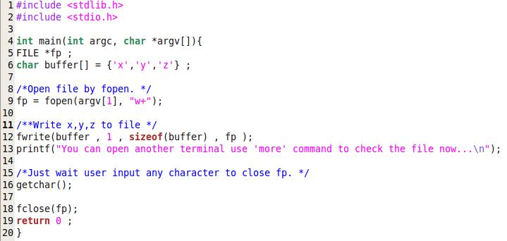
Example 1 : fopen()
Using fopen() function to write data to file.

Slide 9
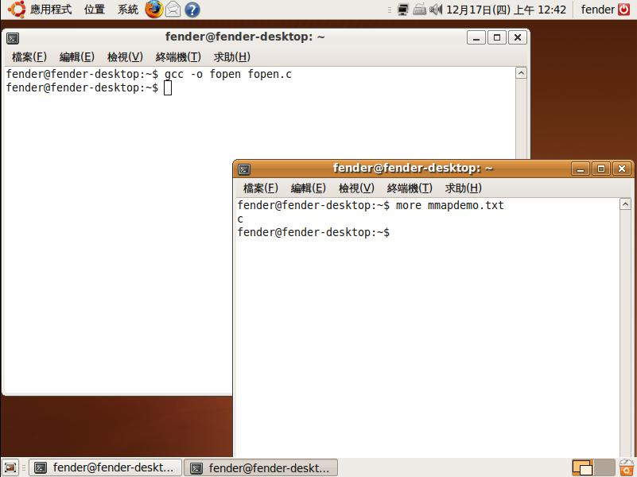
Example 1 : fopen()
Using more command to show file contents.

Slide 10
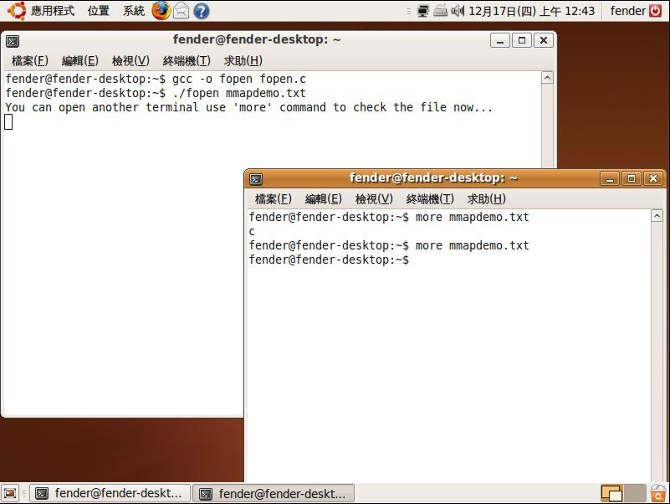
Example 1 : fopen()
Write x, y, z characters to file.
However, you can’t access this file now!

Slide 11
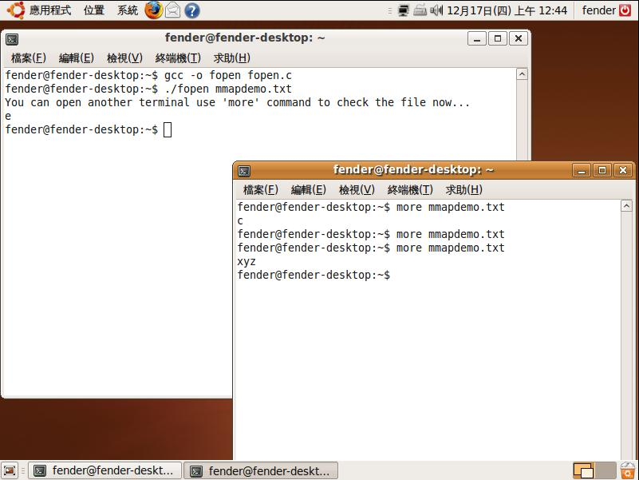
Example 1 : fopen()
Terminating this process.
Access this file again.

Slide 12
Example 2: Using mmap() Function

Slide 13
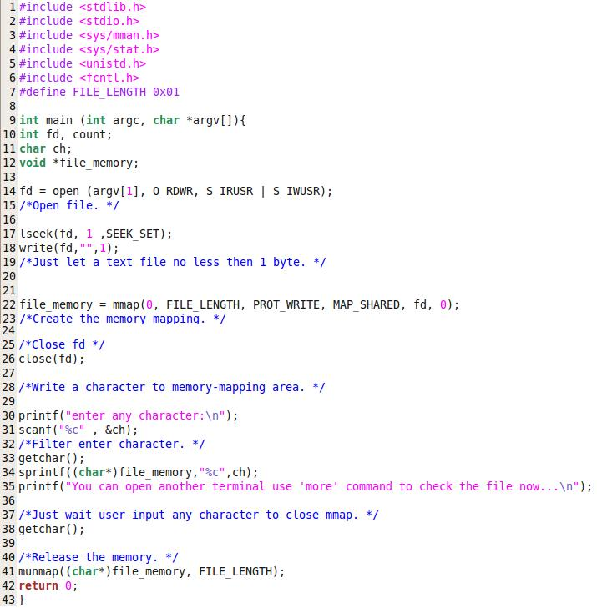
Example 2 : mmap()

Slide 14

Example 2 : mmap()
Using more command to access file contexts.

Slide 15
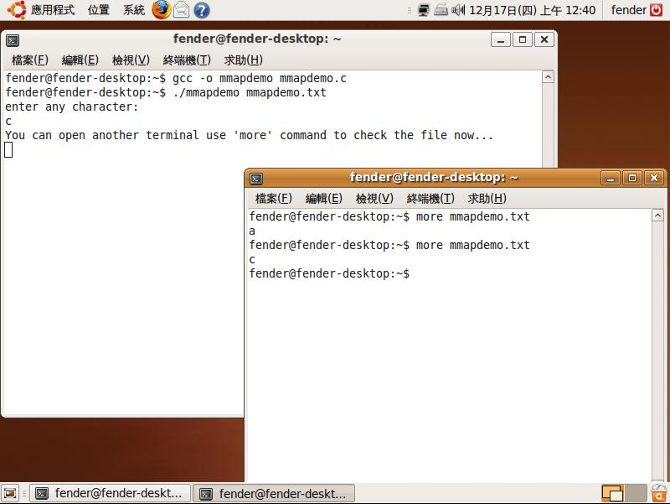
Example 2 : mmap()
Input any character.
Using more command again,
you will find the contents already modified.

Slide 16
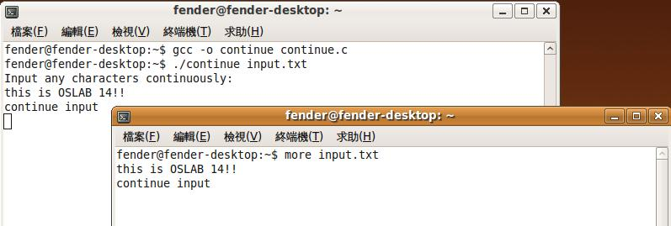
Excises I
Using mmap() function instead of fopen().
Write a program that user can input messages continuously and record these messages into a file.
Use more command to read the file context. [+60pt]
Note :
The memory point that is returned by mmap() will always point to the start of mapped memory region. You should change it’s position by yourself.
Sample result

Slide 17
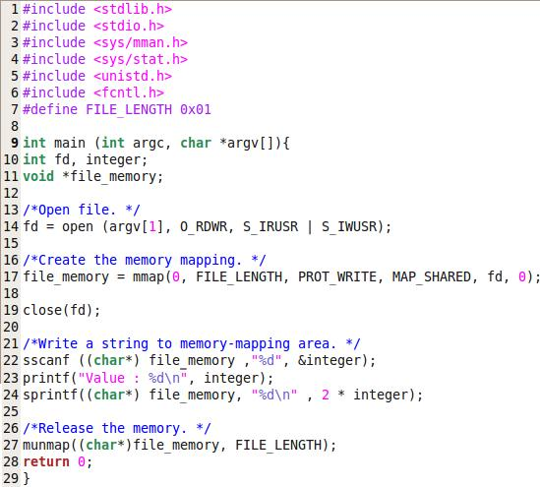
Read file by mmap()
Read the file context and multiple it by 2.

Slide 18
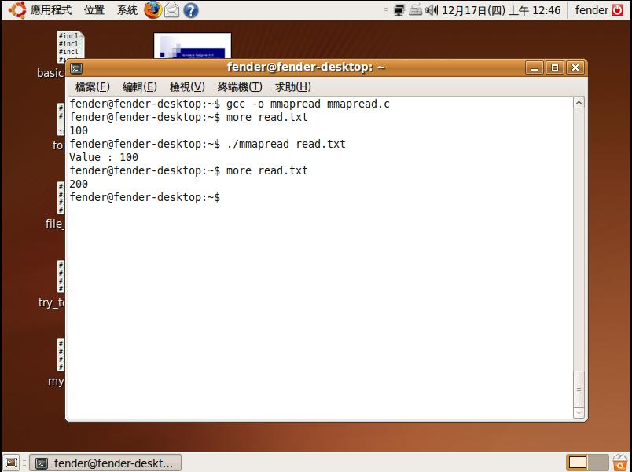
Read file by mmap()
Access the file content.
Access the file content again.

Slide 19
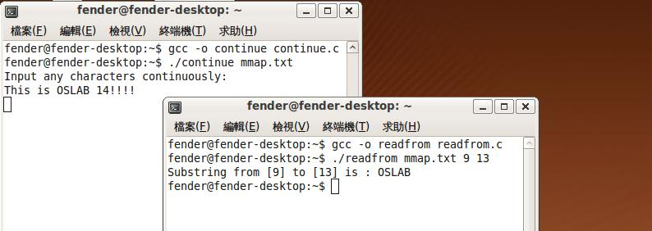
Excises II
Write two programs that use mmap() function.[+30pt]
One program that users can
Input messages continuously and record these messages into a file.
Another program that users can
Read substring from memory mapping area.
Give three parameters: (1)filename (2)start location (3)end location.
Display the substring on the screen.
Sample result

Slide 20
Reference
mmap() function use:
http://www.ibm.com/developerworks/cn/linux/l-ipc/part5/index1.html
http://www.opengroup.org/onlinepubs/000095399/functions/mmap.html
http://nckuhuahua.pixnet.net/blog/post/26152653
http://learn.akae.cn/media/ch28s08.html
Others:
http://gogojesseco.blogspot.com/2009/07/linux-mmap.html
http://book.csdn.net/bookfiles/353/10035313696.shtml
http://hi.baidu.com/xydjh/blog/item/d514a1133fa346075aaf53dc.html

